Slide 1








Microsoft Power Platform
Community Call
Welcome to the August 2022
Power Platform Community Call!
August 17th, 2022

Slide 2
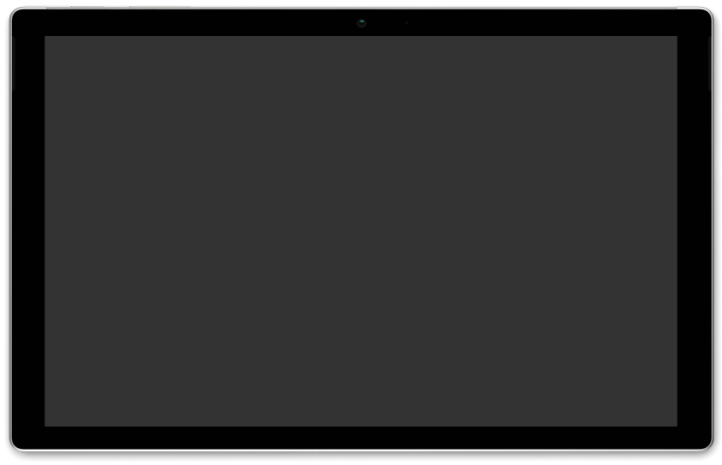







Community Updates:
Power Platform Updates
September Community Call – #MPPC22
Monthly Community Tip
Demos:
Using Forms and Power Automate to Upgrade your Customer Onboarding Experience
– Mary Myers | @MaryMyers_WM
Building a Time Sheeting Canvas App using the Dataverse
– Darren Lutchner | @assist_365
Connecting Power Pages to your Dataverse data
– Hugo Bernier | @bernierh
AGENDA
Microsoft Power Platform monthly community call 17th of August @ 8 AM PT
Download recurrent invite from https://aka.ms/powerplatformcommunitycall

Slide 3
Microsoft Power Platform
Community Call
Welcome to the August 2022
Power Platform Community Call!
August 17th, 2022

Slide 4


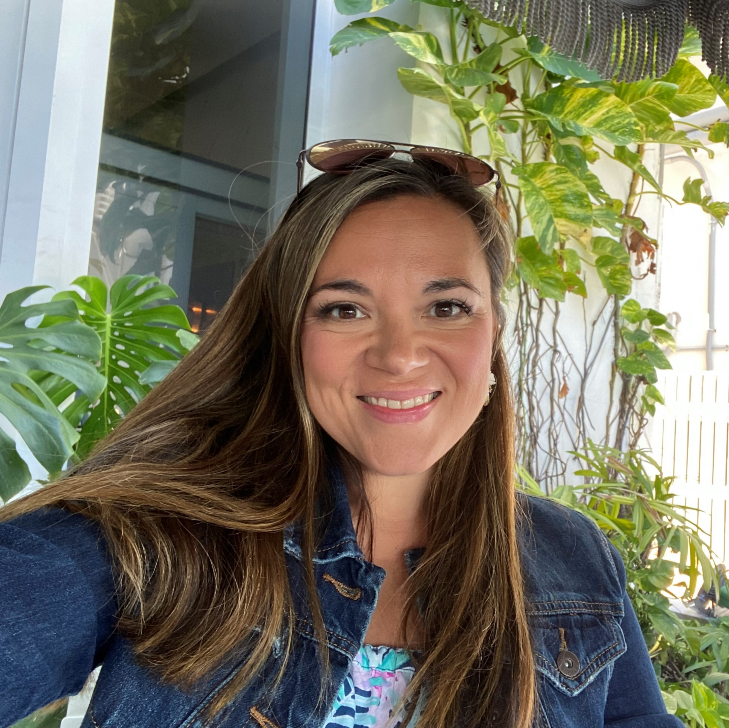


Agenda
Latest updates and news on Power Platform
Monthly Community Tip
Group picture time with Together Mode!
Demos
Mary Myers - Using Forms and Power Automate to Upgrade your Customer Onboarding Experience
Darren Lutchner - Building a Time Sheeting Canvas App using the Dataverse
Hugo Bernier - Connecting Power Pages to your Dataverse data

Slide 5

Community Call Format
Community Updates (15 Minutes)
Demo #1 (15 Minutes)
Demo #2 (15 Minutes)
Demo #3 (15 Minutes)

Slide 6

Request to Present We welcome everyone to present a demo on the Power Platform Community Call. Everyone is welcome!!!
https://aka.ms/PPCCDemoRequest

Slide 7
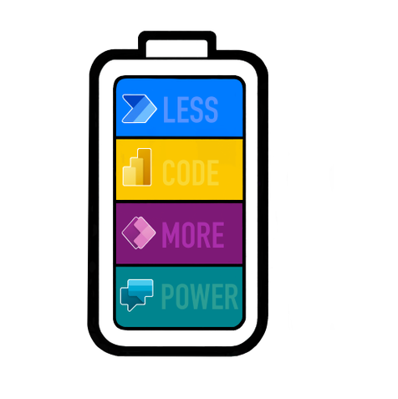
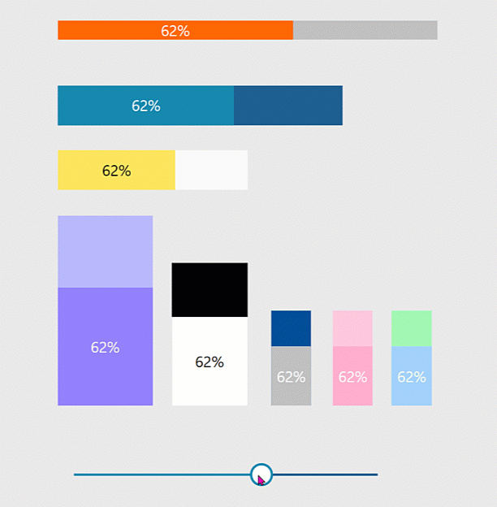
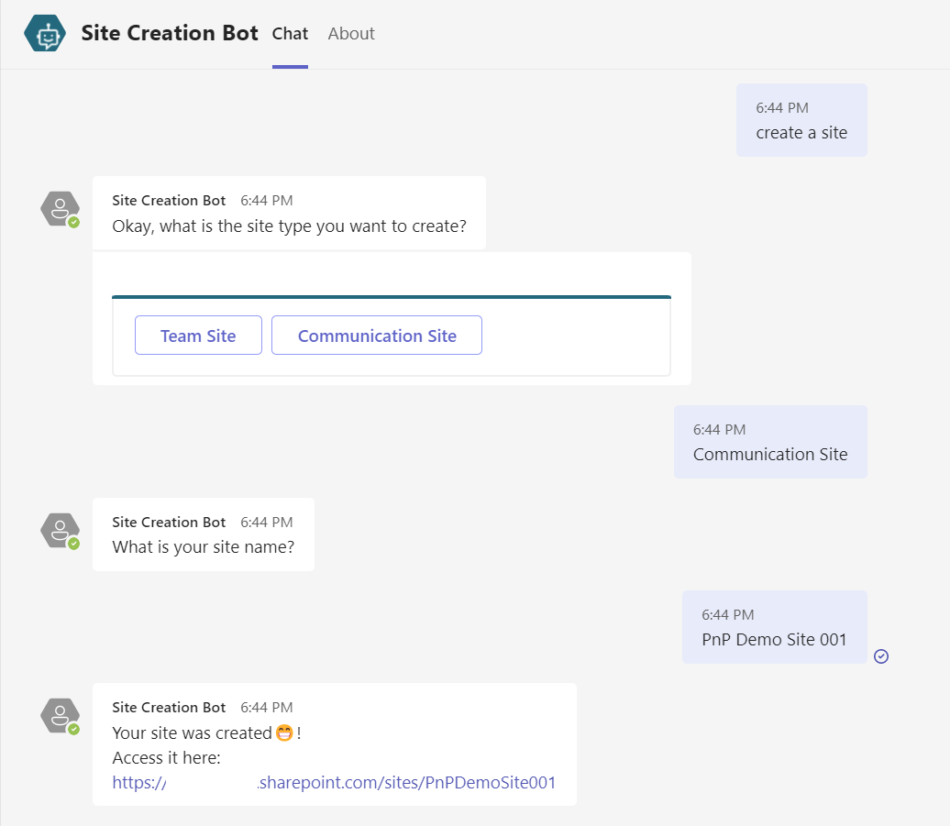
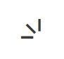


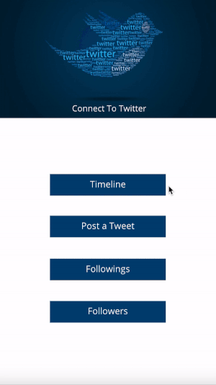
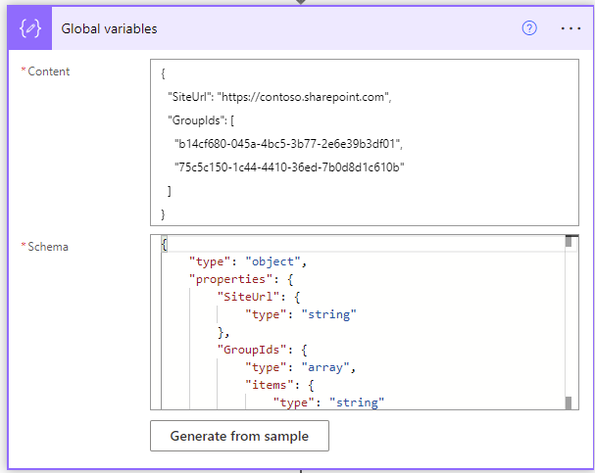

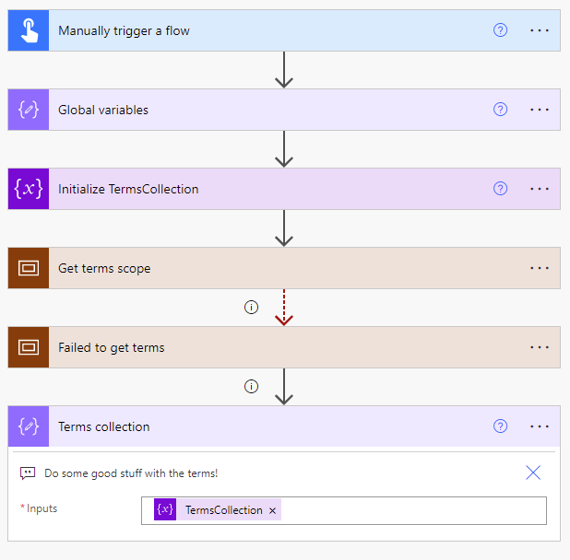
Power Platform Samples
New:
Progress-Bar Components Luise Freese | @LuiseFreese
Twitter Connection Lama Alluwaymi | Lama-alluwaymi
Get terms from Term Store Ramin Ahmadi | @raminahmadi1986
SharePoint Site Creation Bot Michel Mendes | @michelcarlo
aka.ms/powerplatform-samples ​
Notes:
These are the updates that we processed since out last call.
New samples:
- Power Automate: SharePoint Collect Feedback April Dunnam | @aprildunnam Demonstrates:
Executing a Flow from a SharePoint Library with input parameters
Leveraging the custom responses option in Power Automate approvals
https://github.com/pnp/powerautomate-samples/tree/main/samples/sharepoint-collect-feedback
- Power Automate: Get Graph API Data within Power BI Reports Scott McKenzie | @365EDUBI Enables Graph API data to be refreshed within the Power BI Service. https://github.com/pnp/powerautomate-samples/tree/main/samples/graph_api_in_power_bi
Updated samples:
Power App: Fluent UI Custom Theme Fabio Franzini | @franzinifabio Fixed datepicker control theme https://github.com/pnp/powerapps-samples/tree/main/samples/fluentui-custom-theme
These latest samples should show within 24 hours

Slide 8
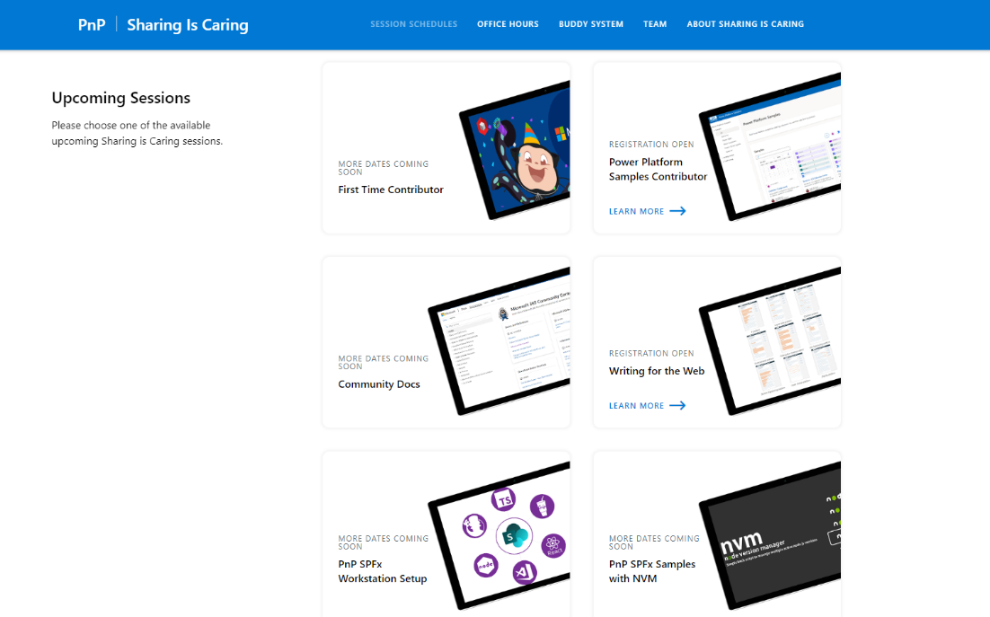
GUIDANCE
Learn how to get started in the open-source community!
Upcoming Sessions:
First-time contributor
Power Platform Samples Contributor
Writing for the Web
Community Content Docs
SPFx Developer Workstation Setup
Using PnP SPFx samples w/ NVM
More than code with VS Code
Coming Soon: Power Pages -- 2 Part Session
Join the Power Platform Contributors
Sharing is Caring Session @ MPPC
https://aka.ms/sharing-is-caring
Notes:
25 Total attendees, 16 attendees who attended both First-Time Contributors and Community Docs sessions.

Slide 9








COMMUNITY
Community Recognition Program
Showcasing your contributions
Powered by Credly
More achievement levels coming soon
https://aka.ms/community-recognition
Notes:
25 Total attendees, 16 attendees who attended both First-Time Contributors and Community Docs sessions.

Slide 10

Power Platform Community Events

Slide 11




Slide 12
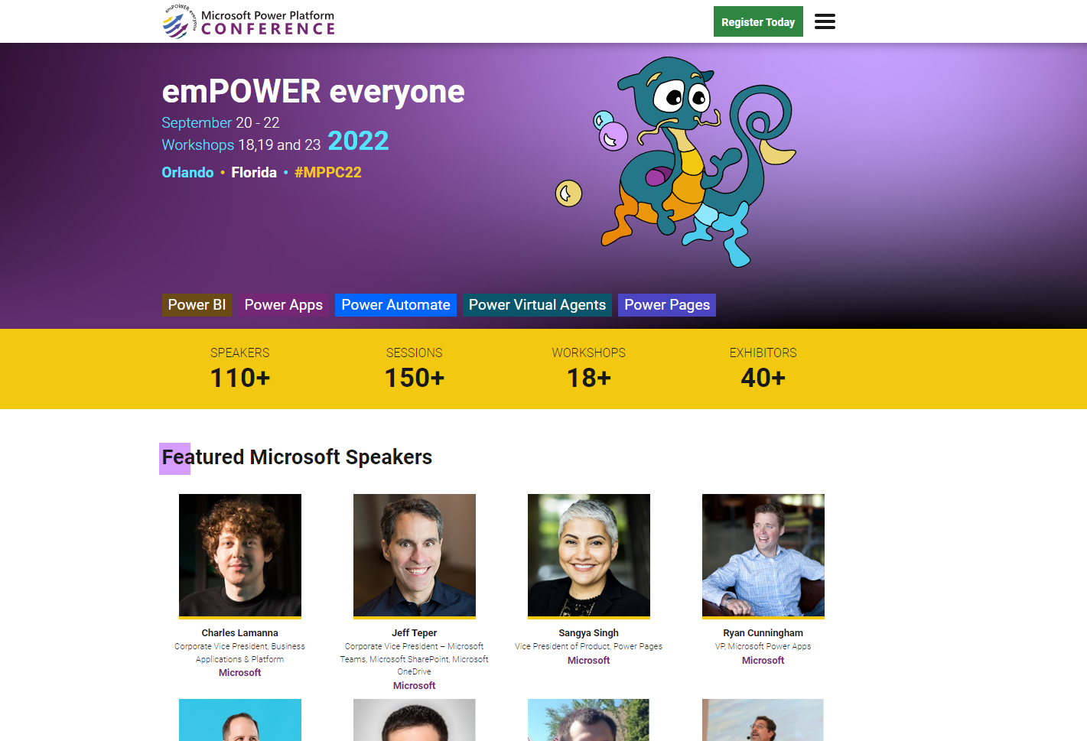
https://powerplatformconf.com/
Notes:
https://powerplatformconf.com/
Early bird ends July 25th

Slide 13

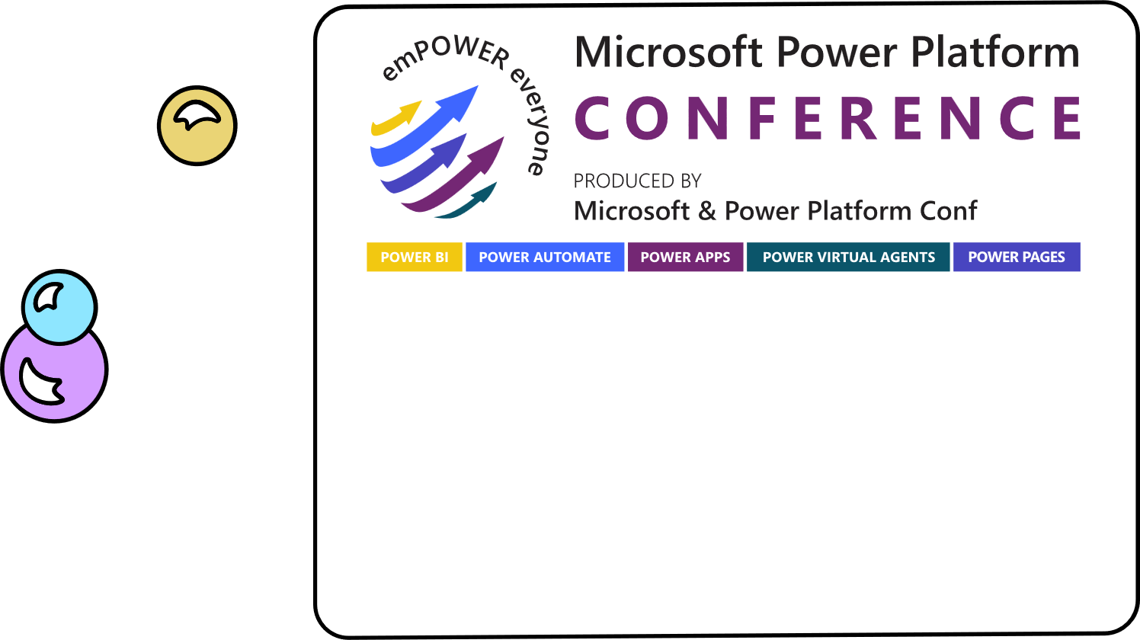
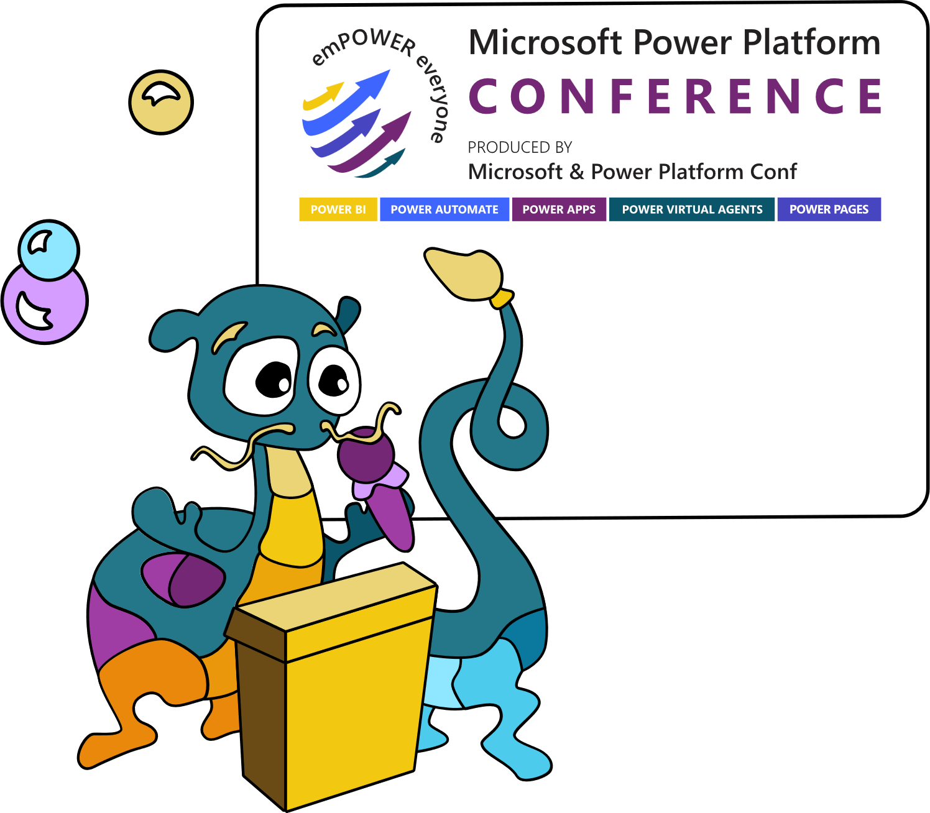


Microsoft Power Platform
Community Call
September 21st – 8am PT
Recurring Invite:
https://aka.ms/powerplatformcommunitycall
Streaming live from the Power Platform Conference!!!

Slide 14
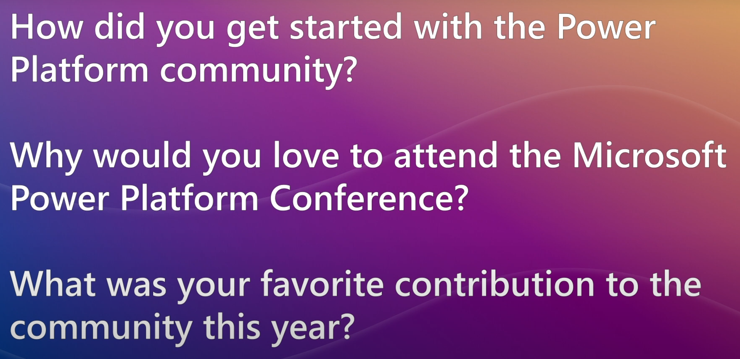
MPPC Community
Give Back
Tell us your story for an opportunity to be selected to receive one complimentary pass to the upcoming Microsoft Power Platform Conference in Orlando, Florida, September 20-22, 2022
https://aka.ms/MPPCGiveBackVideo

Slide 15

Monthly Community Quick Tip
“Remove duplicate rows in collections with one line of code!”
Matthew Devaney
Notes:
This month in the Monthly Community Quick Tip segment I’m excited to share a tip from Matthew! The tip is - How to remove duplicate rows in collections with only one line of code!

Slide 16
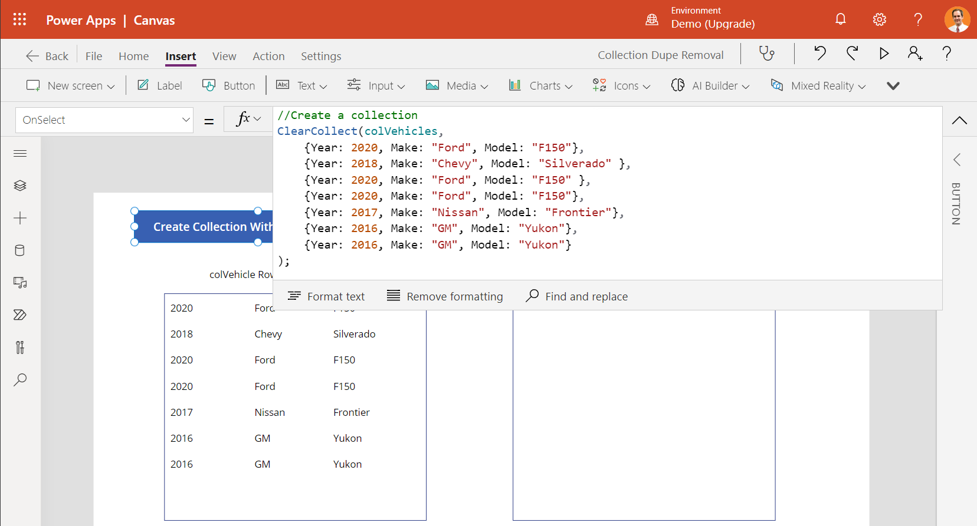
Monthly Community Quick Tip
Remove duplicate rows in Collections with one line of code!
Notes:
To provide an example, first we create a collection with duplicate rows. The collection is bound to the gallery you see on the left side of the screen. Here you can see the Ford F150 and the GM Yukon are duplicate rows.

Slide 17
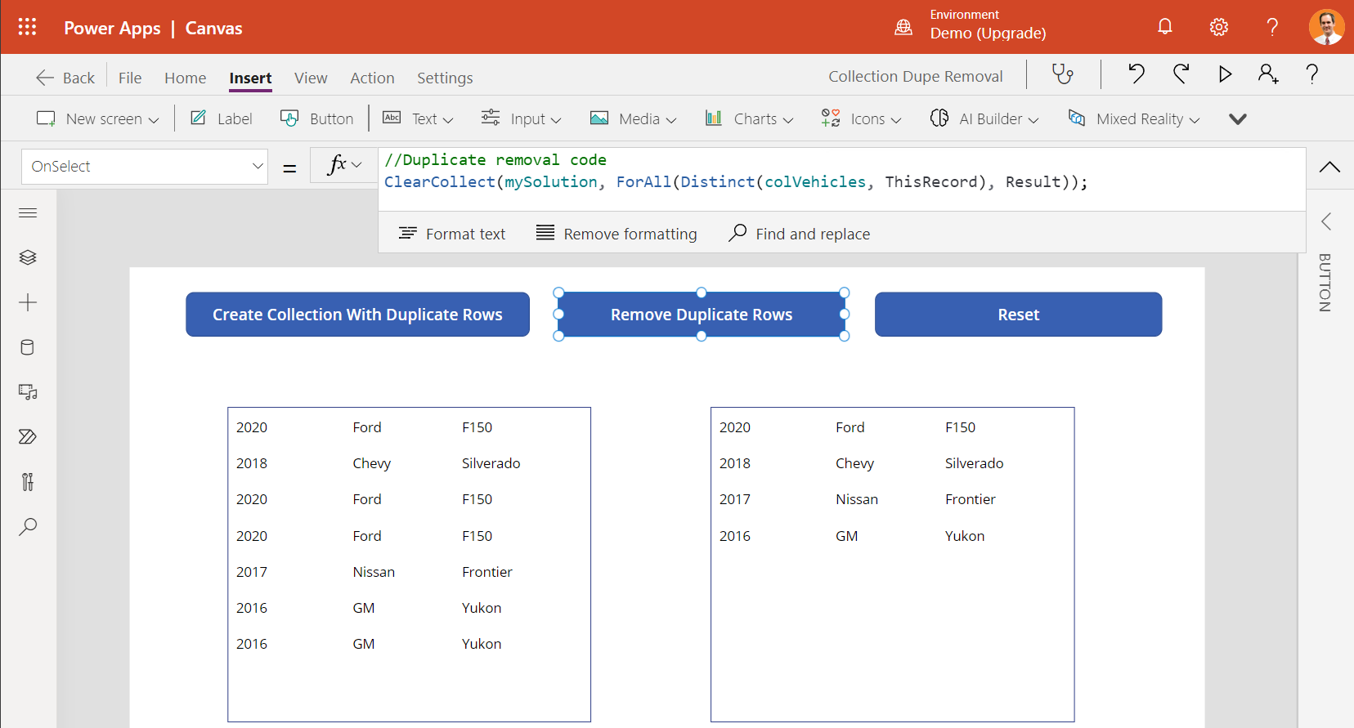
Monthly Community Quick Tip
Remove duplicate rows in Collections with one line of code!
Notes:
Then, we use one line of code to create a new collection that does not contain any duplicates. In this example, the gallery on the right side of the screen is bound to the mySolution collection that does not contain duplicate rows.

Slide 18
Monthly Community Quick Tip
Remove duplicate rows in Collections with one line of code!
Here’s how it works:
1. The Distinct function returns a one-column table of unique values for a field.
2. When we use ThisRecord instead of a column name, it results in a one-column table of unique records.
3. Then, we loop over the one column table using ForAll to extract the rows into a multiple-column table.
Notes:
Here’s how it works:
1. The Distinct function returns a one-column table of unique values for a field.
2. When we use ThisRecord instead of a column name, it results in a one-column table of unique records.
3. Then, we loop over the one column table using ForAll to extract the rows into a multiple-column table.

Slide 19
Monthly Community Quick Tip
Remove duplicate rows in Collections with one line of code!
Learn More!
https://www.matthewdevaney.com/remove-duplicate-rows-from-a-power-apps-collection
Share your Community Quick Tips!
https://aka.ms/PPCCDemoRequest
Notes:
You can learn more about this topic on Matt’s blog. Thanks again for sharing the tip, Matt!
If you have a Quick Tip, please reach out to us and submit your idea and we will present it on the call.
Thanks everyone! Back to you, David.

Slide 20
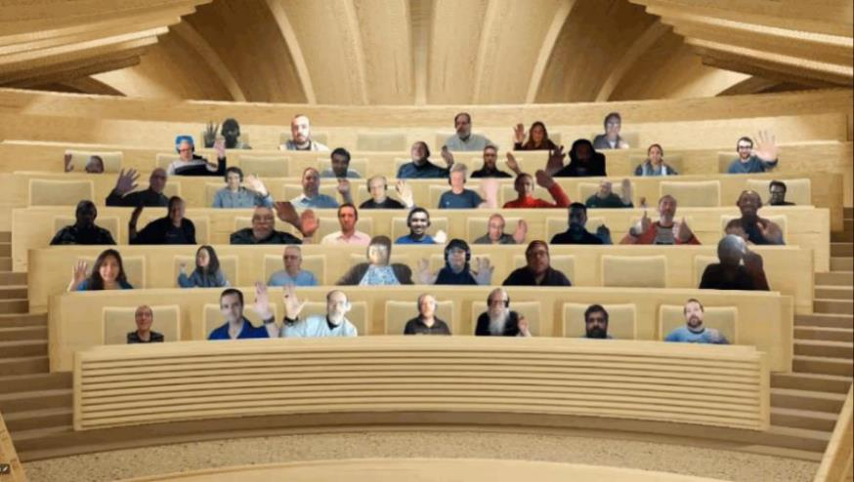

Optional picture time!
Turn your video on and we’ll grab a Together Mode picture with everyone willing to participate.
We are together in this as a community!
By enabling your camera for the picture, you’ll give us the permission to share your picture in social media.

Slide 21


DEMO
Using Forms and Power Automate to Upgrade your Customer Onboarding Experience – Mary Myers
Building a Time Sheeting Canvas App using the Dataverse – Darren Lutchner
Connecting Power Pages to your Dataverse data – Hugo Bernier
Notes:
Notes about each demo go here.

Slide 22
Q&A

Slide 23
Resources

Slide 24
Learn more with these helpful resources!
Power Apps Training Resources
https://aka.ms/PowerAppsTraining
Power Apps Community
https://Community.PowerApps.com
Power Apps Community Samples
https://aka.ms/PowerAppsCommunitySamples
Power Apps Community Videos
https://aka.ms/PowerAppsCommunityVideos
PowerPlatformLearn Resources
https://www.powerplatformlearn.academy
PnP Power Platform Samples
https://www.aka.ms/powerplatform-samples

Slide 25
Microsoft 365 developer community calls
Microsoft 365 platform (weekly) https://aka.ms/m365-dev-call
(Notice. This call is on a summer break between July 1st and 31st of August 2022)
Adaptive Cards https://aka.ms/adaptivecardscommunitycall
Microsoft identity platform https://aka.ms/IDDevCommunityCalendar
Office Add-ins https://aka.ms/officeaddinscommunitycall
Power Platform https://aka.ms/PowerPlatformCommunityCall
Microsoft 365 & Power Platform Development (bi-weekly) https://aka.ms/m365-dev-sig
Viva Connections & SharePoint Framework (bi-weekly) https://aka.ms/spdev-spfx-call
Download recurrent invites from
https://aka.ms/m365/calls
Notes:
m365-dev-sig

Slide 26
Thank you
Recording will be available soon on the
Microsoft 365 Community (PnP) YouTube channel
https://aka.ms/M365PnP/videos
(subscribe today)
Follow us on Twitter
@Microsoft365Dev | @M365PnP
Next call: September 21, 2022 at 08:00am PST
https://aka.ms/powerplatformcommunitycall
See all other community calls at http://aka.ms/m365pnp
Notes:
https://aka.ms/M365PnP/videos
https://aka.ms/powerplatformcommunitycall
http://aka.ms/m365pnp

